Slide 1
INTAIN CAMPUS FINTECH CHALLENGE 2026 · AI TRACK
Loan Performance Intelligence Engine
An end-to-end system that profiles, predicts, explains, and narrates loan-level portfolio risk — from raw servicer data to a governed reviewer copilot.
46,952
4,169
5
23,894
monthly records
unique loans
predicted outcomes
scored submission rows
S.Sharvesh (sharvesh.suresh005@gmail.com)

Slide 2
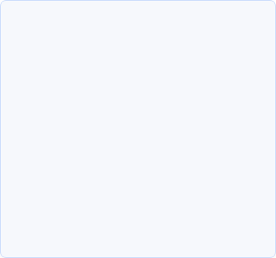




THE PROBLEM
Panel loan data hides risk in plain sight
Data quality is invisible
Single-outcome models under-serve risk teams
Black-box predictions erode trust
Missing documents, stale servicer updates, and status conflicts sit undetected inside monthly loan tapes.
A probability with no driver, no exception flag, and no plain-English rationale is hard to act on.
Reviewers need delinquency, default, prepayment, and next-state — not one score.
OUR APPROACH
A single pipeline that profiles data quality, trains calibrated multi-outcome ML models, models time-to-event survival, flags anomalies, stress-tests scenarios, explains every prediction with SHAP, and lets a governed LLM narrate — never generate — the numbers.
02

Slide 3


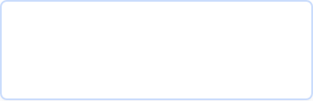




SYSTEM ARCHITECTURE
One pipeline, eight functional requirements
Raw Data (8 files)
→
FR-1 Profiling
→
Feature Engineering
→
Time-Aware Split
FR-2
FR-3
FR-4
Prediction Models
Survival Analysis
Anomaly Detection
LightGBM · delinquency, default, prepayment, next-state
Discrete-time hazard model · handles right-censoring
Isolation Forest + rule engine on validation_rules.json
→
→
FR-8 · AI Development Log runs continuously across every stage above
03

Slide 4




FR-1 · DATA INTELLIGENCE
Every field profiled before a model sees it
46,952 monthly records across 4,169 loans, spanning 2022–2024, profiled for distributions, missingness by servicer and state, and a per-record data quality score.
WHY IT MATTERS
3,158
records with a missing document
Every issue this stage surfaces directly drives a downstream signal — nothing is profiled and then ignored.
469
◆ Missing documents → document_gap exception flag (FR-4)
multivariate outliers flagged (1.00%)
◆ Stale servicer timestamps → stale_servicer_update flag (FR-4)
◆ Field-level quality score → input to anomaly_score weighting
1,857
total records requiring exception review
◆ Drift & association stats → logged in data_intelligence_report.md
04

Slide 5
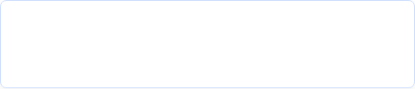


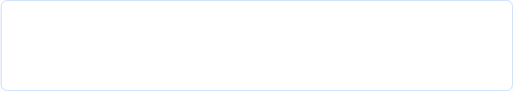
FEATURE ENGINEERING & SPLITTING
36 features, zero leakage
FEATURE FAMILIES
TIME-AWARE SPLIT — NEVER RANDOM
Lag features
Previous DPD, previous balance, and month-over-month changes — capture payment momentum.
2022 2024
TRAIN → Jun 2024 TEST Oct 2024
Ratio features
Balance ratio, rate spread — normalize across loan sizes and rate regimes.
Staleness features
Panel data means random row-level splits leak future months into training. The cutoff is fixed at 2024-07-01 — this is the single most important step for preventing leakage.
Time since last servicer update — surfaces reporting lag.
36
engineered features feed every downstream model — prediction, survival, and anomaly detection all share one feature stack.
05

Slide 6












FR-2 · PREDICTION MODELS
From a naive baseline to a calibrated LightGBM
Logistic Regression (baseline)
Tuned LightGBM (improved)
*AUC of 0.99 with PR-AUC context documented in model_performance_report.md — evaluated on strictly held-out, time-separated test data.
Why LightGBM for all five targets
One library, one API, fast iteration. Class imbalance handled via scale_pos_weight; isotonic calibration converts raw scores into empirical probabilities the copilot can narrate.
06

Slide 7

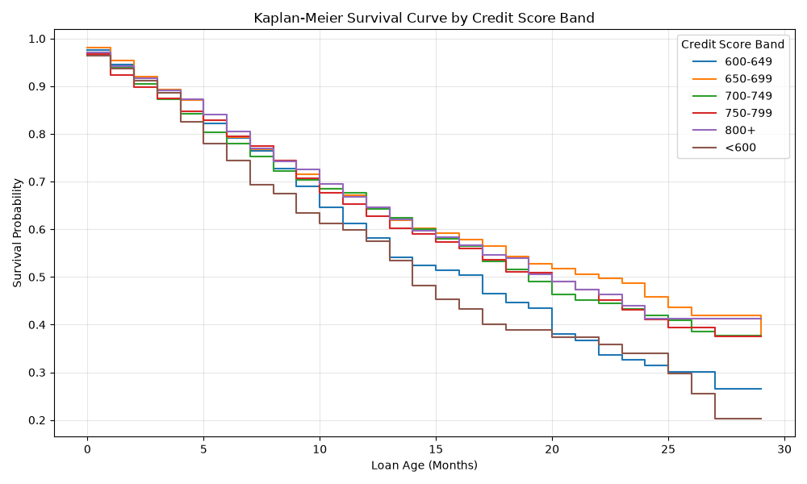
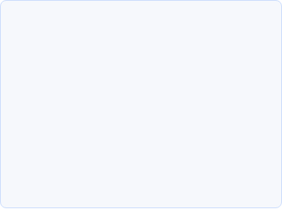
FR-3 · SURVIVAL ANALYSIS
Not just if a loan fails — when
MODEL AUC
0.9976 hazard model
0.5146 flat baseline
Discrete-time hazard model correctly handles right-censored loans still active at period end.
KEY INSIGHT
Loans under 600 credit score fail roughly twice as fast as higher bands — visible directly in the curve's steeper early drop.
Design choice: only lag features are used (current-month DPD excluded) to prevent within-loan temporal leakage.
07

Slide 8

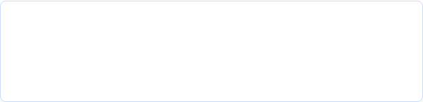
FR-4 · ANOMALY DETECTION
Hybrid rules + Isolation Forest catch what models miss
EXCEPTION TYPE BREAKDOWN
1,857
document_gap 1161
records flagged for exception review
stale_servicer_update 736
balance_mismatch / other -40
Example: LN000000
Anomaly score 0.733
HOW IT WORKS
Deterministic rules from validation_rules.json take precedence and set the exception_type. Isolation Forest layers a continuous anomaly_score on top, catching multivariate outliers that no single rule would trip.
08

Slide 9

FR-5 · SCENARIO SIMULATION
Stress-testing the portfolio before the market does
Base Case
Adverse Credit
600–649 band impact
current macro trajectory
8.5% unemployment, HPI −10%
hit hardest under stress
47.6%
+52.4 pts
9.65%
HONEST LIMITATION
Prepayment response is muted because synthetic data doesn't capture rate-spread sensitivity — documented explicitly, not hidden.
09

Slide 10
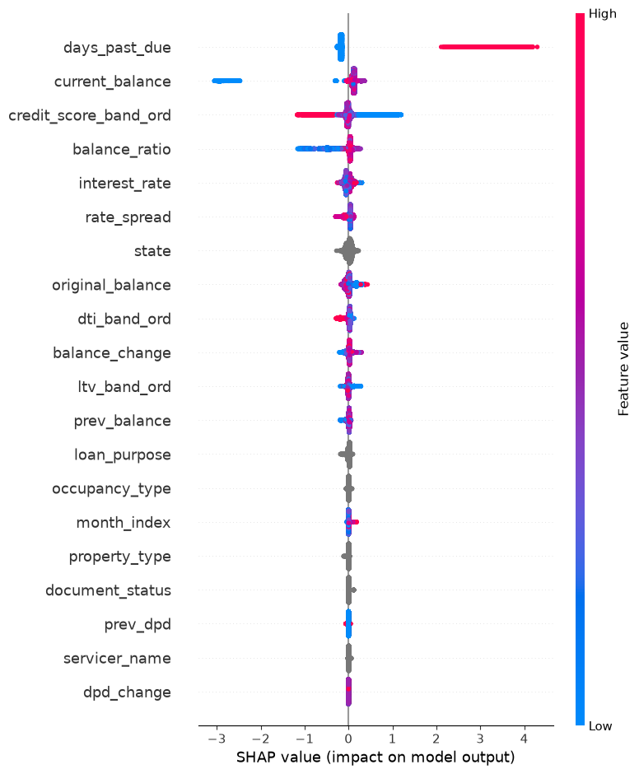
FR-6 · EXPLAINABILITY — GLOBAL VIEW
Every prediction is explainable, not just accurate
SHAP GLOBAL SUMMARY
Delinquency model — top drivers
days_past_due
Dominant driver — high DPD pushes risk sharply up
current_balance
Larger balances trend protective in this cohort
credit_score_band
Lower bands consistently raise predicted risk
balance_ratio
Captures principal paydown momentum
Global summaries exist for all three predictive models, alongside documented false-positive and false-negative patterns.
10

Slide 11

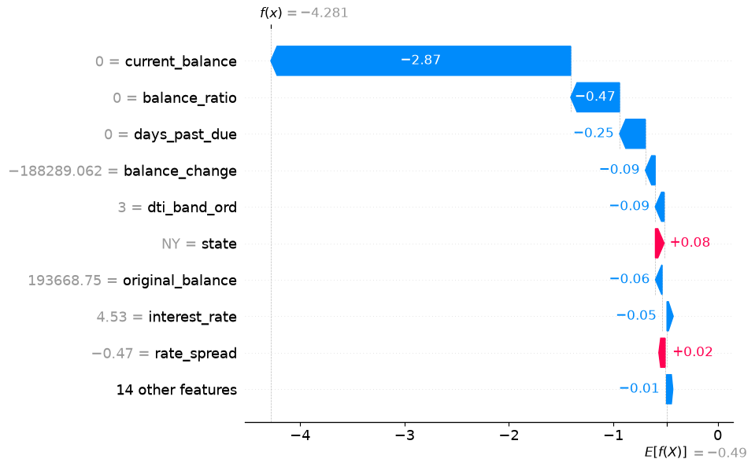

FR-6 · EXPLAINABILITY — LOCAL VIEW
Why this loan, specifically
LOAN LN000000
SHAP waterfall — one prediction, fully decomposed
current_balance is the single largest driver, pulling the prediction down by −2.87.
balance_ratio and days_past_due add smaller downward contributions.
Every field, value, and contribution shown here is retrieved directly from the trained model — nothing is generated by an LLM.
11

Slide 12

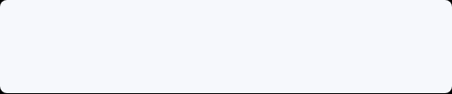








FR-7 · LLM REVIEWER COPILOT
The LLM narrates the numbers — it never invents them
DOCUMENTED FAILURES — CAUGHT & CORRECTED
GROUNDED, NOT GENERATIVE
Gemini API, with a deterministic MockLLM fallback so the pipeline always completes — API key or not.
Hallucinated a value
LLM invented an anomaly score when the field was missing from context.
Reads:
Overclaimed certainty
Said a loan WILL default — rejected for stating a probability as fact.
Explained a phantom feature
Writes:
Referenced a feature that doesn't exist in the model.
A plain-English reviewer note — always labeled "Recommendation — not a decision."
Every LLM output is labeled: “Recommendation — not a decision”
12

Slide 13


SUBMISSION & DELIVERY
One command, a complete deliverable
23,894
15
0
42×
rows
columns
nulls
reproducible seed 42
Every row carries probabilities across 4 horizons, a predicted next state, confidence, anomaly score, exception type, top SHAP drivers, and a labeled LLM recommendation.
DISQUALIFIER AUDIT — SELF-VERIFIED
✓ Predictions come from trained ML, not LLM calls
FR-8 · AI DEVELOPMENT LOG
✓ Time-aware split — no random row-level leakage
Every prompt, every accepted and rejected output, logged continuously throughout the build — not written retroactively. It shows where the AI got things wrong and how it was corrected.
✓ All 7 target columns excluded from feature matrix
✓ Every metric from actual held-out evaluation runs
Thank you.
13

